Slide 1
Comparative Evaluation of Mannitol and Hypertonic Saline in the Treatment of Experimental Traumatic Brain Injury CNI: RFP#17-002- A262-76756
Alex Valadka M.D.
Dong Sun, MD, Ph.D.
Department of Neurosurgery
Medical College of Virginia
Virginia Commonwealth University
Richmond, VA, U.S.A

Slide 2
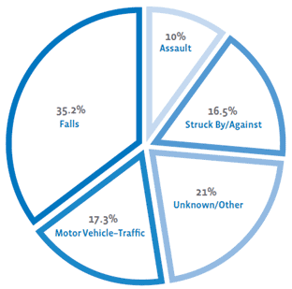
The Facts and Onset of TBI
*statistics from Centers of Disease Control and Prevention*
Notes:
Facts and Statistics
- Definition of Mild TBI: person who has had a traumatically induced physiological disruption of brain function, as manifested by a least one of the following:
any period of loss of consciousness;
any loss of memory for events immediately before or after the accident;
any alteration in mental state at the time of the accident (eg, feeling dazed, disoriented or confused); and
focal neurological deficit(s) that may or may not be transient;
Causes and Leading Causes:
- Falls cause half (50%) of the TBIs among children aged 0 to 14 years and 61% of all TBIs among adults aged 65 years and older.***

Slide 3
Traumatic Brain Injury

Slide 4
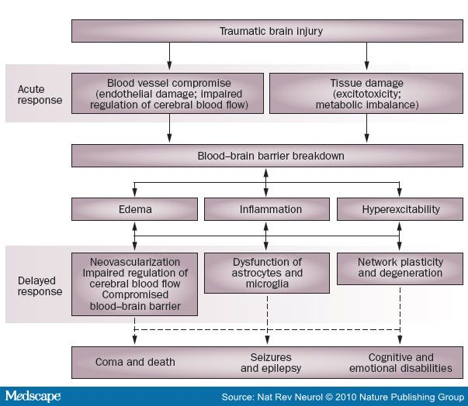
Primary and Secondary responses following TBI
Notes:
4
Talk about cellular response and protein changes, published in literature following TBI
-

Slide 5
Consequences of severe TBI
Elevated intracranial pressure (ICP): pressure greater than 20mmHg, due to brain edema (vasogenic and cytotoxic)
ICP: a reflection of the relationship between changes of craniospinal volume and the ability of the craniospinal axis to accommodate the changed volume.
Raised ICP is associated to poorer outcome.

Slide 6
ICP management
Decompression surgery: temporary removal of large portion of the skull (provide injured brain with extra room to swell) - worsening outcomes and high complication rate were reported.
Hypothermia, chemically induced coma, shunt
Osmotic treatment: Mannitol, Hypertonic saline (osmotic properties cause water to move from injured brain parenchyma into circulating, thus reducing edema; reduce blood viscosity, promote vascular autoregulation and lower cerebral blood volume).
Osmotic treatment particularly HTS is widely used in clinic to treat elevated ICP. However, there is no guideline for its usage. No clinical or animal studies have systemically investigated the optimal dosing, timing, frequency, pharmacodynamics, side effects and long term outcomes. This proposal will fill this gap.

Slide 7
Objectives
Aim 1: To compare the effects of mannitol and HTS at different concentrations on ICP, brain water content, inflammation, and early neuronal cell death immediately after experimental TBI.
Aim 2: To examine long term neuroprotective properties of mannitol and HTS: functional recoveries and brain tissue preservation after experimental TBI.

Slide 8
Experimental Plan
Two rodent (rat) TBI models:
Controlled cortical impact injury model (CCI):
-Pneumatically powered metallic rod driven into the brain tissue.
-Allows for a focal area of injury that can be easily distinguished from uninjured areas of the brain.
-Can replicate clinical symptoms ranging from mild to sever by adjusting the depth and velocity of impact of the metallic rod.
Lateral fluid percussive injury model (LFPI):
-Fluid pulse applied to the brain through craniotomy to induce a mixture of focal and diffuse injury.
-Higher rates of morbidity.
-Indirect indices thus more variables.
-Difficult to consistently reproduce.

Slide 9
TBI-induces transient ICP increase in TBI animal models
Reid et al., 2010. J Neurotrauma 27.

Slide 10
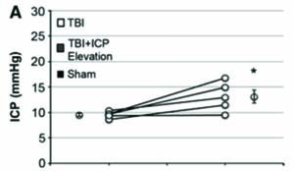
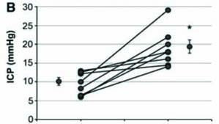
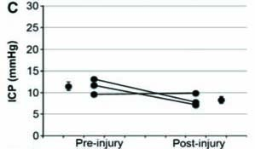
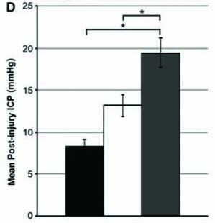
Strategies to increase ICP following TBI in animal model:saline intraventricular infusion
Lafrenaye et al., 2014, JCBFM 34

Slide 11
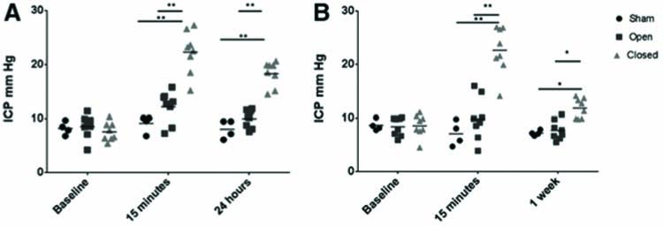
Strategies to increase ICP following TBI in animal models: Bone flap reseal
Friess et al., 2015, J. Neurotrauma 32.

Slide 12
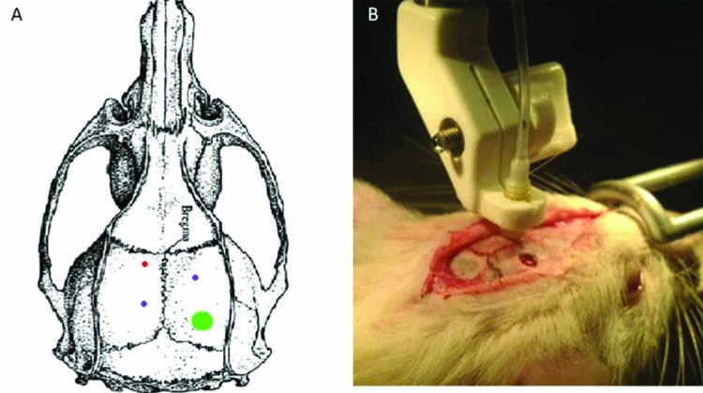
Surgical procedure:

Slide 13
Experimental procedures
ICP probe implantation, femoral artery and vein cannulation (Aim 1) (ventral tail artery and left jugular vein for Aim 2 study).
TBI (LFPI/CCI)
ICP, MAP (mean arterial pressure) and CVP (central venous pressure) monitoring
Osmolar treatment: Group of animals: 1). Sham, 2). CCI+0.9% saline, 3). CCI+20% mannitol (0.5-1g/kg), 4). CCI+3.2% HTS, 5). CCI+7.5% HTS, 6). CCI+23.4% HTS, 7). LFPI+0.9% saline, 8). LFPI+20% mannitol (0.5-1g/kg), 9). LFPI+3.2% HTS, 10). LFPI+7.5% HTS, 11). LFPI+23.4% HTS (n = 8/group).
A bolus volume of equiosmolar HTS or mannitol will be infused through the femoral vein over a 5-minute period using an infusion pump. After treatment, animals will remain on the surgical table and be monitored for ICP for 6 hrs. If a single bonus injection will not decrease ICP below 20 mm Hg, multiple doses will be administered as needed, stopping if serum osmolality reaches 320 mOsm/kg.

Slide 14
Outcome assessment
Biochemical analysis: arterial blood gases and for determination of hematocrit, serum osmolality, and sodium concentration. Levels of serum Na, creatinine, and BUN will be measured, as well as blood viscosity.
Brain water content
Acute inflammation, cell death, tissue damage
Long term effect: motor and cognitive functional recovery; neuronal cell loss; axonal injury and white matter atrophy; glial cell response.

